Slide 1
Laudato Si
Reflection on Action
Sisters, Servants of the Immaculate Heart of Mary

Slide 2
As professional, religious women,
the Sisters, Servants of the Immaculate Heart of Mary of Immaculata, PA
have always striven to reach heights
of apostolic commitment.

Slide 3
The challenging and sobering call of Laudato Si
for renewed awareness and action
to care for Planet Earth
– our common home –
did appear as
a “mountainous” endeavor.

Slide 4

steps
upward
small
The response, therefore, began with

Slide 5
In 2021, the Congregational Leadership
asked the Social Justice Coordinator
to spearhead the creation of
an IHM response and commitment
to Laudato Si principles.

Slide 6

Sisters volunteered to serve on a committee
to develop the IHM Laudato Si Action Plan.
The Administration chose a co-chair for this committee.
In May 2022, the committee submitted both
the 2021 reflection and the
2022-2023 first year action plan,
which the Laudato Si Action Platform approved.
Scaling this mountainous endeavor had begun!

Slide 7

The committee,
inspired by the philosophy of the Serenity Prayer,
strove to convey to the membership
that although we could not change everything,
each one could embrace a commitment
and a creative way
to address climate change
one small step
– one action –
at a time.

Slide 8
They also clarified that
this would not be a quick sprint to the top, but
a slow, carefully prepared ascent together
to the Laudato Si Mountain
of attitudinal change.

Slide 9
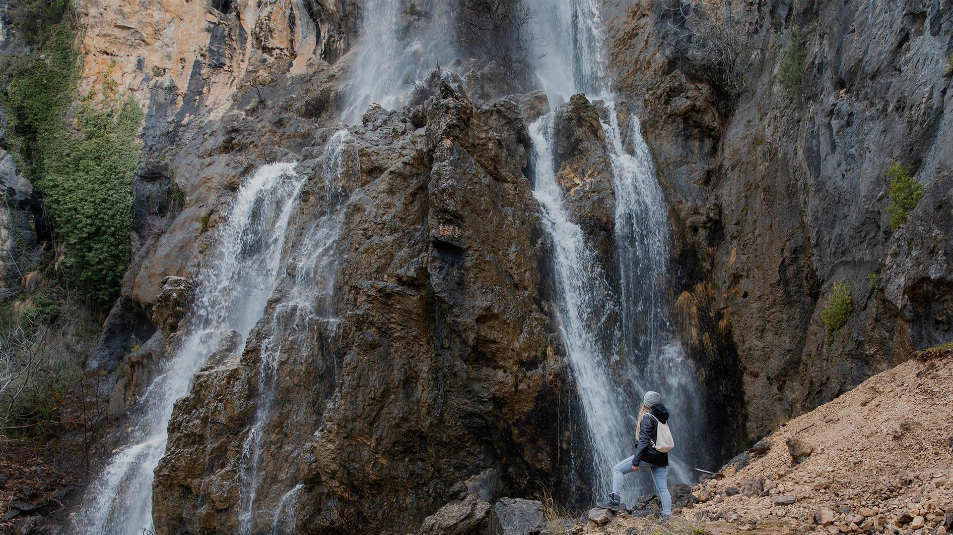
The committee acknowledged
that the membership might be overwhelmed
by the enormity
of reaching greater
ecological awareness
and transformative action,
and so, as helpful guides would,
they assisted everyone to prepare for the climb.

Slide 10
The committee chose Ecological Education
as the goal for 2022-2023,
which enabled the sisters,
whose main apostolate is education in all forms,
to see the reality of the mountain,
but more importantly,
to learn the skills to master it
with incremental steps.

Slide 11
As a first step,
the committee presented a video
to the entire Congregation
which explained the process
and distributed personal pledge cards
(a commitment to the journey)
during a meeting with local leadership teams.

Slide 12
In each local community,
the Social Justice Representative
accepted the role of Laudato Si Representative
and received the Year 1 Action Plan (“our climbing gear”).
The role of the Laudato Si Representative
was to keep the climbers focused on the goal
and readied for the ascent.

Slide 13
For four months, the potential “climbers”
studied the Laudato Si terrain:
Carbon Footprint,
Water,
Recycling,
Conservation of Natural Resources.

Slide 14
Then, each local community decided
which of the four sides of this mountain
would be their starting area.
The plan had to be
realistic,
measurable
and concrete.

Slide 15
For the next four months, sisters began the climb
and consistently assessed progress,
their knowledge of the task,
and how best to rely on
and support one another,
remembering that the goal for ascending this mountain
was conversion – becoming climbers –
not accumulation
of grand success at the top!

Slide 16
Stationed at the first “base camp” in June 2023,
we assessed the higher levels yet to be reached
and the gear and teamwork utilized
to reach this current level.
The journey thus far
had pushed the local communities
and individual sisters forward
with actions such as…

Slide 17




Recycling, and when a township does not,
seeking an avenue to do so.
Reducing the use of plastic by intentionally purchasing products sold in more recyclable packaging.
Being attentive to the use of electricity,
even unplugging from receptacles when not in use.
Trying to use fewer paper products when possible.

Slide 18
In consensus,
the committee decided
to continue to concentrate on
Ecological Education
as our peak.

Slide 19
In September 2023,
the committee will map the direction for Year 2
with the intention
to tweak, upgrade or change
aspects in the overall plan.

Slide 20
Each local community
will then assess the “gear” (pillars)
and choose to retain the same pillar,
but increase or enhance their action plans
or choose another pillar entirely.

Slide 21
In the coming years, it is our hope that,
as did the humorist, Andy Rooney,
we will realize,
“Everyone wants to live on top of the mountain,
but all the happiness and growth occurs
while you’re climbing it.”

